Slide 1

Investing
Essential Questions
How does the time value of money effect the future value of an investment?
Why is it important to diversify your investments?
How are liquidity and diversification related?
How do you know which type investment is best for you?
“It takes money to make money”
(70-20-10, PYF, cash management tools, growth investments, stocks, real estate, appreciate, depreciate,
collectibles, mutual funds, broker, commission, 401K/IRA/social security, tax deferred/ deductible/exempt, simple interest, rule of 72, compound interest, time value of money, principal, rate of return)

Slide 2

Spending, Saving, & Investing
Google images
Savings: Income not spent on current consumption or taxes
Investing: Setting money aside for longer-term goals. Money could be lost, but higher potential return
70-20-10 Rule
  70% Spent
  20% Saved
  10% Invested
PYF ( Pay yourself First)
  - 20% Saved
  - Fixed Expense

Slide 3

CASH MANAGEMENT TOOLS
(Income Investments)
Six types of cash management tools:
  Checking Account
  Savings account
  Money Market Account
  Certificate of Deposit (CD)
  Bonds
  Retirement Accounts
  p. 35 – NEFE BOOK

Slide 4




Growth Investments
Investments that involve a degree of risk, but also a higher potential R.O.R than income investments
Stocks
Real Estate
Collectibles
Mutual Funds
3-H

Slide 5


Stocks
A stock is a portion of the ownership of a corporation.
Equity Capital: Does not have to be repaid
Private vs. Public
Stock exchange, stock index
Stock classifications
Advantages:
High potential R.O.R
Ownership in a company
Vote in company decisions
Disadvantages:
High risk
No guarantee of dividends
Time consuming
Stock indicators: Beta, P/E ratio, EPS
Reading a stock ticker

Slide 6
Real Estate
Real Estate: Land and anything that is attached to it.
  Home Equity: Difference between selling price & amt. you owe
    Appreciation – general increase in value of a property.
    Depreciation – general decrease in value of a property.
    Direct Investment vs. Indirect Investment
http://www.investopedia.com/video/play/intro-to-investment-real-estate#axzz1cCDFWuQy
Types of Property:
  Residential Property: Individual’s largest asset
  Commercial Property: Produce rental income
  Real Estate Investment Trusts (REITs)
    Combines funds to invest in real estate.
http://www.investopedia.com/video/play/flipping-properties#axzz1cCDFWuQy

Slide 7
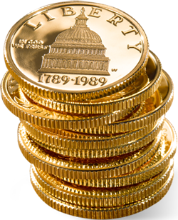




Collectibles
An item of worth or value that is collected
Advantages
High potential R.O.R
Interest
Disadvantages
Illiquidity
High Cost
Fraud

Slide 8
Mutual Funds
Investment that pools money from multiple investors to invest
in stocks, bonds, & other securities
Advantages: Diversification, professionally managed, convenient
Disadvantages: Lack of control, fees & costs
Types of Mutual Funds:
Stock Mutual Funds: (aggressive, growth, equity, index)
Bond Mutual Funds
Mixed Mutual Funds
EXAMPLE
http://www.investorguide.com/mutual-fund.php?symbol=FBGRX

Slide 9
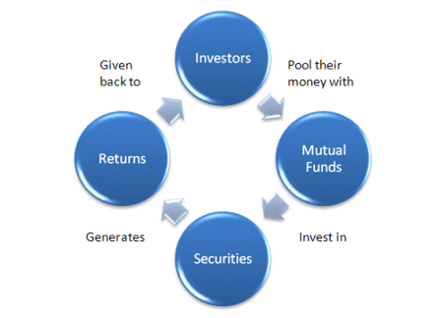
http://www.investopedia.com/video/play/introduction-mutual-funds#axzz1cCDFWuQy

Slide 10

Brokerage Firm
Broker: Person who acts as a go between for buyers and sellers of securities.
Commission: Fee charged by a brokerage firm for the buying and/or selling of a security.
Fee-only: charge hourly rate
Investments
Bonds
Stocks
Mutual Funds
Financial Counseling
Real Estate Investment
Retirement Plan Accounts

Slide 11
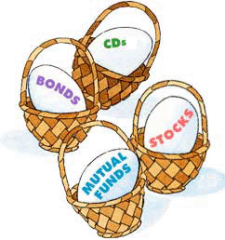
Vocabulary
Diversification: Reducing investment risk by putting money in several different types of investments.
Speculative Investment: a high-risk investment that might earn a large profit in a short time
3-A

Slide 12
Retirement Accounts
Tax-deferred: taxed at later date (401K/403B/IRA)
Tax-exempt: income that is not taxed (Muni Bonds)
Tax-deductible: Reduces taxable income
  Vesting/Becoming Vested : The right of an employee to keep the company’s contributions to his/her retirement plan. Become vested at a specific time. ( 5 years)

Slide 13

Google Images
Retirement Accounts
  Defined Benefit Plan: Specifies benefits employee will receive at retirement based on earnings and experience. (Example : Pension)
  Why is it becoming less & less common???
  Defined Contribution Plan: Specifies contributions made by an employee / employer to a retirement account. (401K/403B/IRA) – WD @ 59 ½
  Contributions guaranteed, not earnings
  Most are tax-deferred
  Social Security: Social Insurance System (93% of Americans qualify)
  Based on earnings – statement w/ credits
  Currently 2.9 workers for each beneficiary. By 2035, there will be 2.1

Slide 14
Retirement Accounts
  IRA : Tax-deferred, tax deductible retirement account in which money is invested in your choice of stocks, bonds, mutual funds, etc.
  - Employer usually does not match
  -Set up by you, managed by you or your financial advisor
  ROTH IRA : Non Tax Deferred account managed the same as an IRA.
http://www.investopedia.com/video/play/understanding-your-401k#axzz1cCDFWuQy

Slide 15
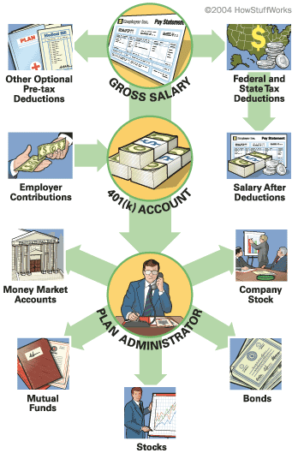

Slide 16
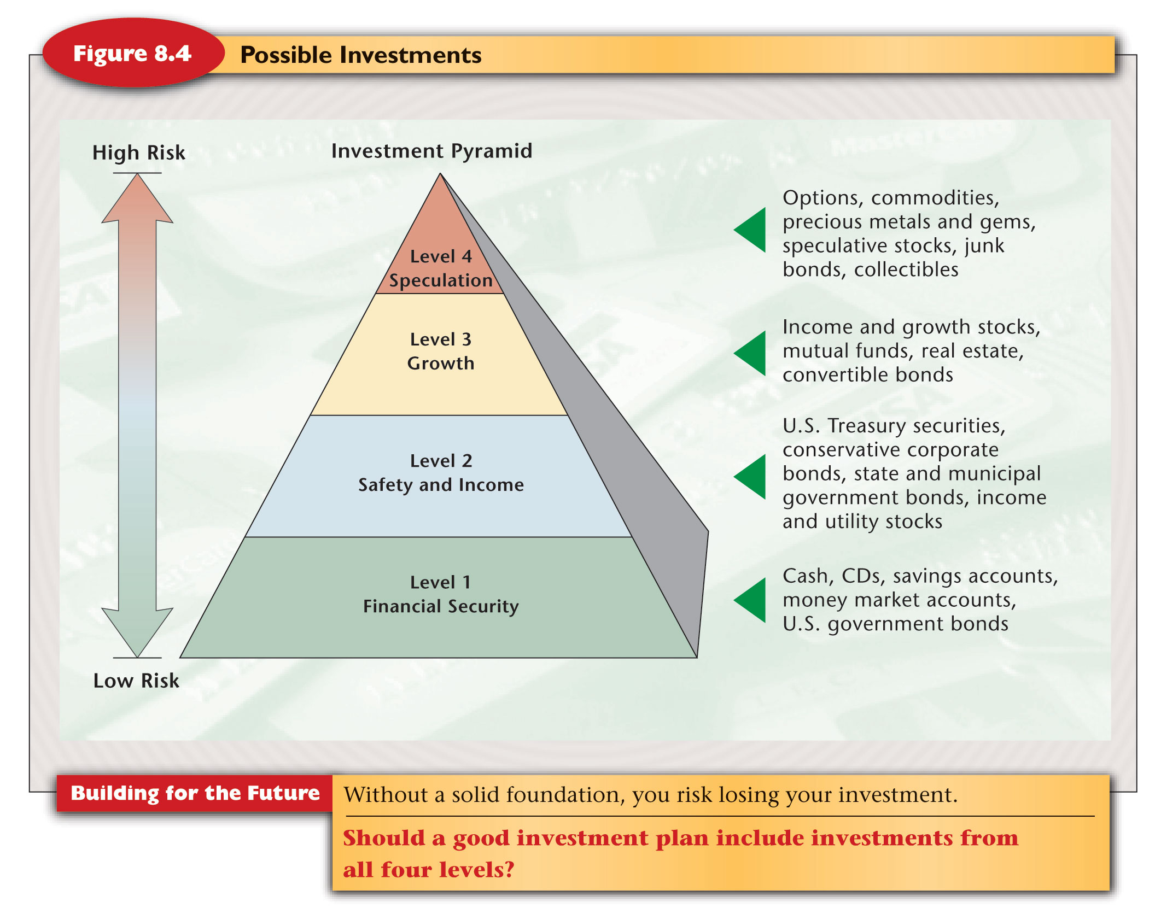

Slide 17


Time Value of $
Refers to the relationship between time, money, and rate of interest.
The more money you have to save/invest now (P/PV), the more you will have in the future (FV).
2. The higher the rate of interest (r), the more money you are likely to have.
3. The sooner you invest, the more time (t) it has to make new money & the more you will have

Slide 18
Simple Interest
Simple Interest: Earning interest only on principal
Interest = Principal x Interest Rate x Time
I = P x r x T
$100 in an account that earns 3% interest for 1 year.
How much interest are you earning?
How much do you have in the account?

Slide 19
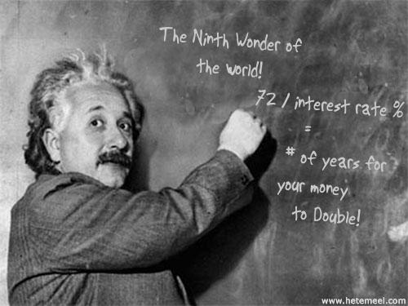
The Rule of 72
72
=
Years Needed to
Double Investment
Interest Rate
72
=
Interest Rate
Required
Years Needed to
Double Investment
Limitations
Is only an approximation
Requires the interest rate to remain constant
Interest earned is reinvested
“It is the greatest mathematical discovery of all time.”
Can Tell You
Years it will take to double an investment (or debt)
How long it will take debt to double if no payments are made
Interest rate needed to double an investment given a time

Slide 20
Example #1: Doug’s CD
Doug invested $2,500 into a Certificate of Deposit earning a 7% interest rate. How long will it take Doug’s investment to double?
Invested $2,500
Interest Rate is 7%
72 | = | _____ years to double investment
7
Notes:
11

Slide 21

Compound Interest
Earning interest on interest
A = P (1+ r/n)^{nt} or FV = PV (1+r/n) ^{nt}
  A = amount in the account
  P = principal (which is the original amount invested)
  r = interest rate expressed as a decimal
  n = number times per year interest is compounded
  t = number of years invested
Ex. Invest $100 at 10% for 1 year compounded 1 time a year
After year 1:_____?
Invest $100 at 10% for 1 year compounded 365 times a year
After 1 year:______?
http://www.investopedia.com/video/play/what-is-compound-interest#axzz1cCDFWuQy
http://www.econedlink.org/interactives/index.php?iid=2

Slide 22
Compounding Interest
Simple Interest
Invest $5,000 at 10% interest for 10 years (compounded once a year)
Interest = ?
Total Amount = ?
Compound
Invest $5,000 at 10% interest for 10 years (compounded daily)
Interest = ?
Total Amount = ?
Ex. 1
FV= ?
PV = $2,500
r = 4%
n = 12
t = 15 yrs
Ex. 2
FV= ?
PV = $3,500
r = 9%
n = 12
t = 25 yrs

